Slide 1

Hello Everyone
Detection of Autism Spectrum Disorder by Feature Extraction of EEG Signals
Presented By
Tushar Sarkar
ID: 18CSE035
Department of CSE, BSMRSTU
Supervised By
Md. Ferdous
Lecturer
Department of CSE, BSMRSTU
Bangabandhu Sheikh Mujibur Rahman Science and Technology University

Slide 2
Outline
Introduction
Related Works
Methodology
Expected Result
Conclusion
Reference

Slide 3
Introduction
Autism Spectrum Disorder (ASD) is a complex condition that affects how people behave and communicate.
ASD is difficult to diagnose because it appears differently in each individual and can range from mild to severe.
It's really important to find out if someone has ASD so they can get the right help.
Background
To understand more about ASD we will look at brain signals, called EEG.
By studying these signals, we can find specific patterns linked to ASD.
There are some problems with the methods we use now to diagnose ASD, so we will explore better, more accurate ways.
Motivation
Develop a new feature extraction method to detect ASD using EEG signals.
Make it easier to find out if someone has ASD, so we can better help them.
Combine brain science and technology to learn more about ASD.
Objectives

Slide 4
Methodology
Time-domain feature extraction
Frequency-domain feature extraction
Decomposition-domain feature extraction
Joint time-frequency domain feature extraction
Spatial domain feature extraction
mRMR feature extraction
Higuchi’s Fractal feature extraction

Slide 5
Methodology(Cont.)
Data Type
Electroencephalogram (EEG) Data
Clinical Data
Feature-Extracted Data
Diagnostic Labels
Demographic Data
Machine Learning Output

Slide 6

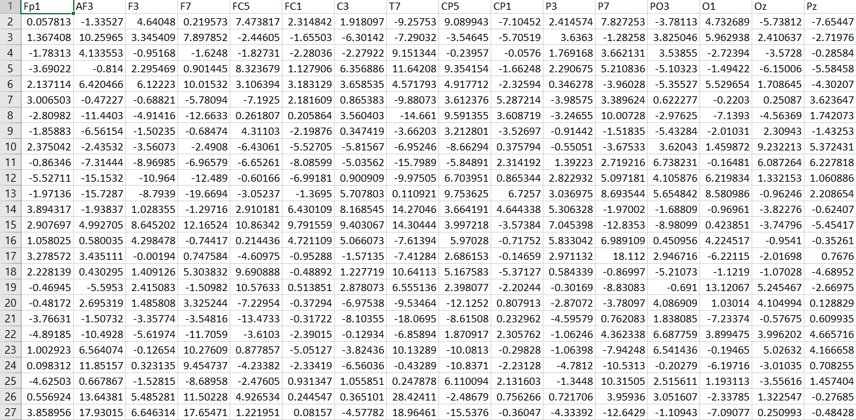
Methodology(Cont.)
Data Sources

Slide 7
Methodology (Cont.)
Data Collect
Research Methods
Data Processing
Feature Selection
Result
Training Dataset
Validation Dataset
Validate
Test Dataset
Build Model

Slide 8
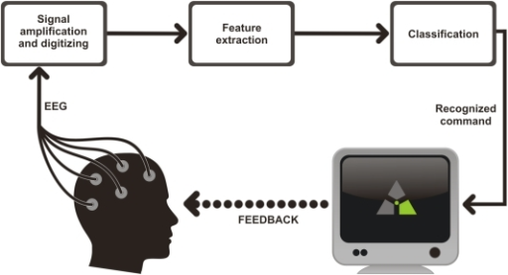
Expected Result
We aim to develop a machine learning model that effectively uses EEG signals to distinguish between individuals with Autism Spectrum Disorder (ASD).
We expect that the new feature extraction model can demonstrate high accuracy and robustness, demonstrating its potential for practical application in early ASD detection.
Additionally, we anticipate identifying specific EEG features that serve as reliable biomarkers for ASD, contributing valuable insights to the field.

Slide 9
Conclusion
Successful extraction of EEG features demonstrated efficacy in distinguishing ASD patterns.
The developed machine learning model showcased promising diagnostic potential.
EEG-based biomarkers offer non-invasive and objective means for ASD detection.
Acknowledging limitations, future directions include larger datasets and interdisciplinary collaboration.
Overall, our study contributes to advancing ASD diagnosis, emphasizing the importance of EEG signal analysis.

Slide 10
Reference
Zahrul Jannat Peya, Md. Ferdous, M. A. H. Akhand, Mohammed Golam Zilani, Nazmul Siddique-2021. ASD Detection using Higuchi’s Fractal Dimension from EEG, Springer, pp. 102-115.
N. A Ali, A.R Syafeeza, A. S Jaafar, M.K Mohd Fitri Alif-2020. Autism spectrum disorder classification on electroencephalogram signal using deep learning algorithm, Springer, pp. 91-99.
Jie Zhao, Jiajia Song, Xiaoli Li,Jiannan-2021, A study on EEG feature extraction and classification in autistic children based on singular spectrum analysis method, Springer, pp. 118-130.
Berna Ari a, Nebras Sobahi b, Ömer F. Alçin c, Abdulkadir Sengur a, U.Rajendra Acharya-2022. Accurate detection of autism using Douglas-Peucker algorithm, sparse coding based feature mapping and convolutional neural network techniques with EEG signals, Springer, pp. 217-228.

Slide 11
Thank you Everyone

